Slide 1
TIES4560 Demo 4
Suvi Kaasalainen,
Leevi Liimatainen,
Petra Puumala,
Teemu Vähä-Impola

Slide 2
Task 4 - REST Web Service (with Jersey)
- Background and Business logic are continued from previous tasks
- We implemented Basic Authentication and Digest Access Authentication

Slide 3
Authorization
We let Jersey manage authorization with JSR-250 annotations such as @PermitAll, @DenyAll, @RolesAllowed and specified SecurityContex.
We implemented two roles: admin and user
Admin role is made for company’s employees and with that role all methods are allowed
We hard coded one admin account and that can give admin rights to others
User role is made for customers and customer can register to service
Users can:
View and update own informations
Delete own account
View information about rooms available and equipments in those

Slide 4
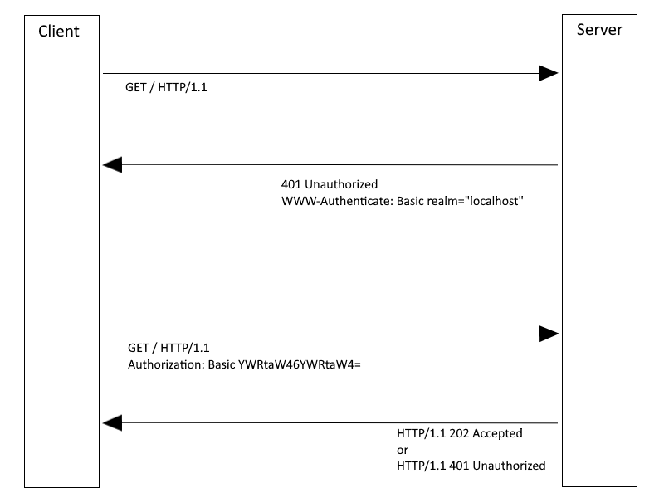
Basic Authentication Flow

Slide 5
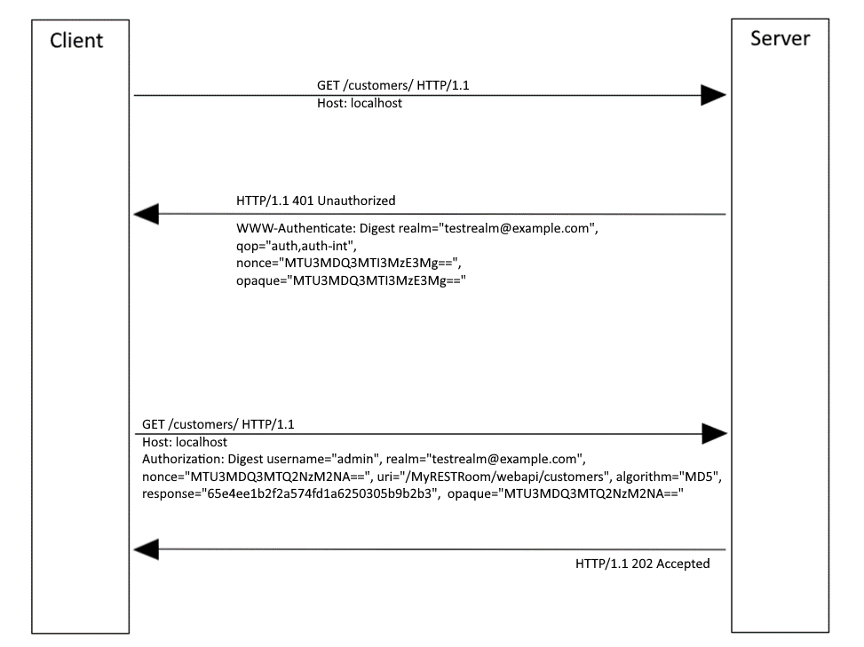
Digest Authentication Flow

